Slide 1
Lab 1 Figures

Slide 2
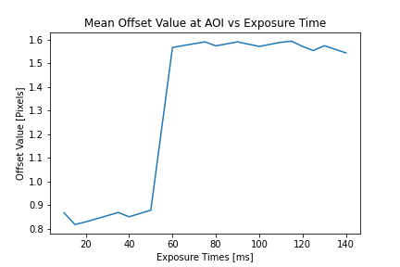
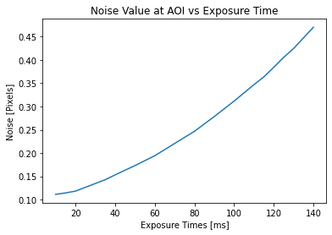
A
Full Field Frame-Averaged Image
B
0
200
400
600
800
1000
16
14
12
10
8
6
4
2
0
Pixels
0 200 400 600 800 1000 1200
Pixels
Noise Image
C
0
200
400
600
800
1000
12
10
8
6
4
2
0
Pixels
0 200 400 600 800 1000 1200
Pixels
Figure 2: Mean Offset Values and Noise for Dark Images
A) Full field frame-averaged and noise no-light images for 50 frames. Images taken with a DCC3240M CMOS camera. B) Line graph of mean offset values versus exposure time from 100 frames of dark images taken at 17 different exposures. C) Line graph of noise values, represented by variance, versus exposure time from 100 frames of dark images taken at 17 different exposures.

Slide 3
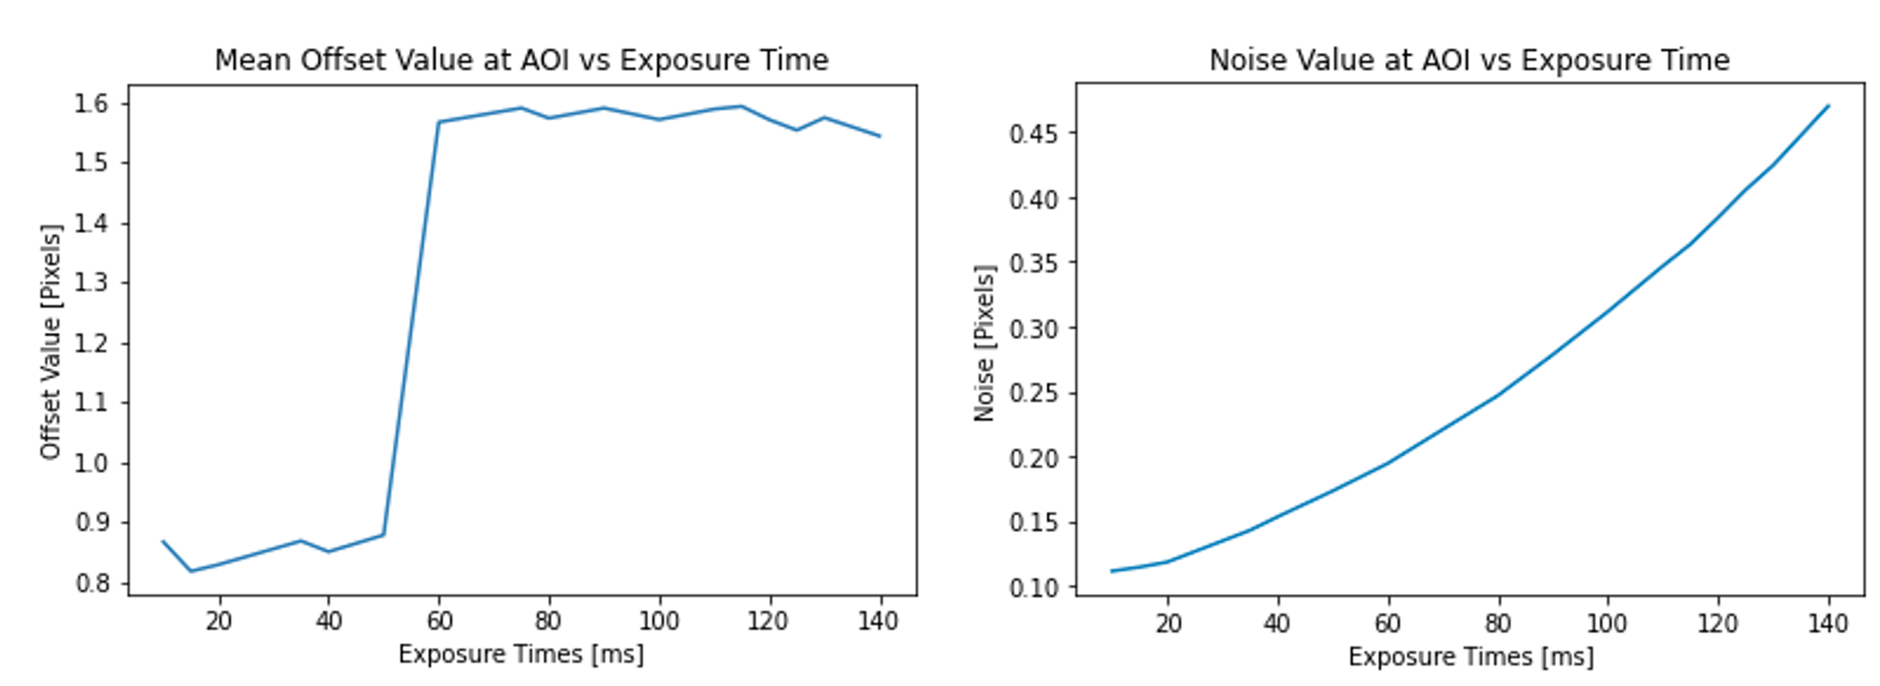

Slide 4
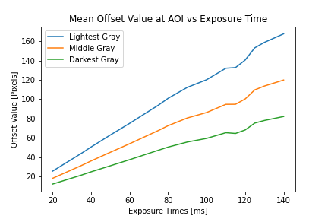
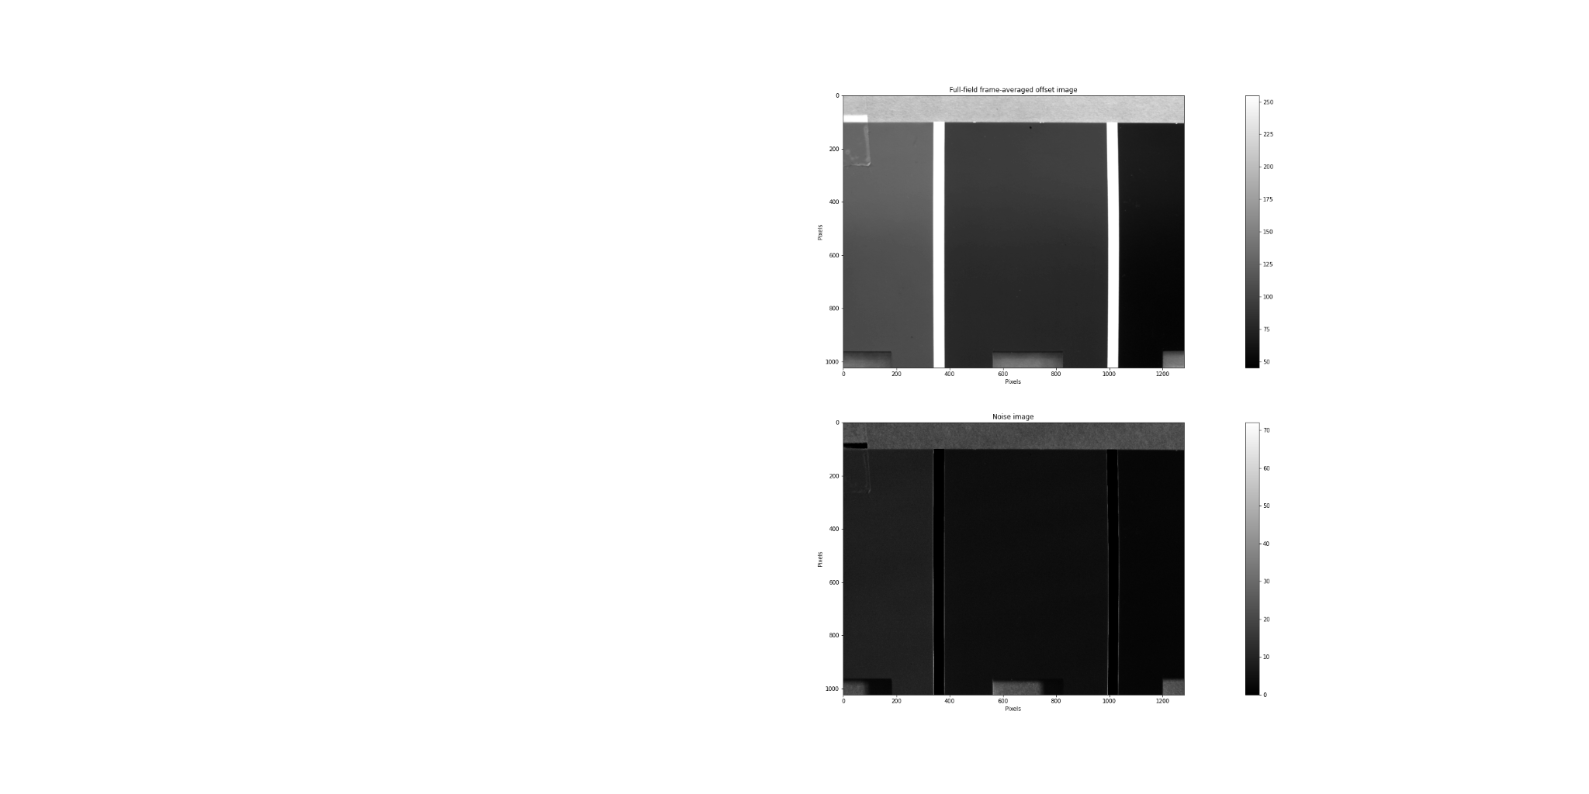
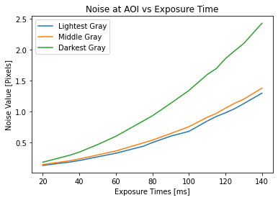
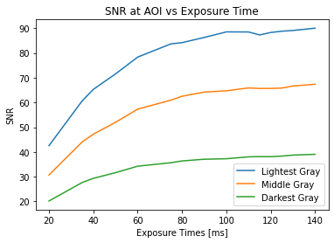
A
Full Field Frame-Averaged Image
B
0
200
400
600
800
1000
250
225
200
175
150
125
100
75
50
Pixels
C
0 200 400 600 800 1000 1200
Pixels
0
200
400
600
800
1000
Noise Image
Pixels
D
0 200 400 600 800 1000 1200
Pixels
Figure 3: Mean Offset Values, Noise, and Signal-Noise Ratio for Different Shaded Imaging Planes
A) Full field frame-averaged and noise images for 100 frames at exposure of 120 ms, aperture at 6, and focus at 3.75. Images taken
with a DCC3240M CMOS camera. B) Line graph of mean offset values versus exposure time taken at 17 different exposures. Images include three Areas of Interest (AOIs) of three uniform shades. C) Line graph of noise values, represented by variance, versus exposure time taken at 17 different exposures. Images include three AOIs of three uniform shades. D) Line graph of Signal-Noise Ratio (SNR) values versus exposure time taken at 17 different exposures. Images include three AOIs of three uniform shades.

Slide 5
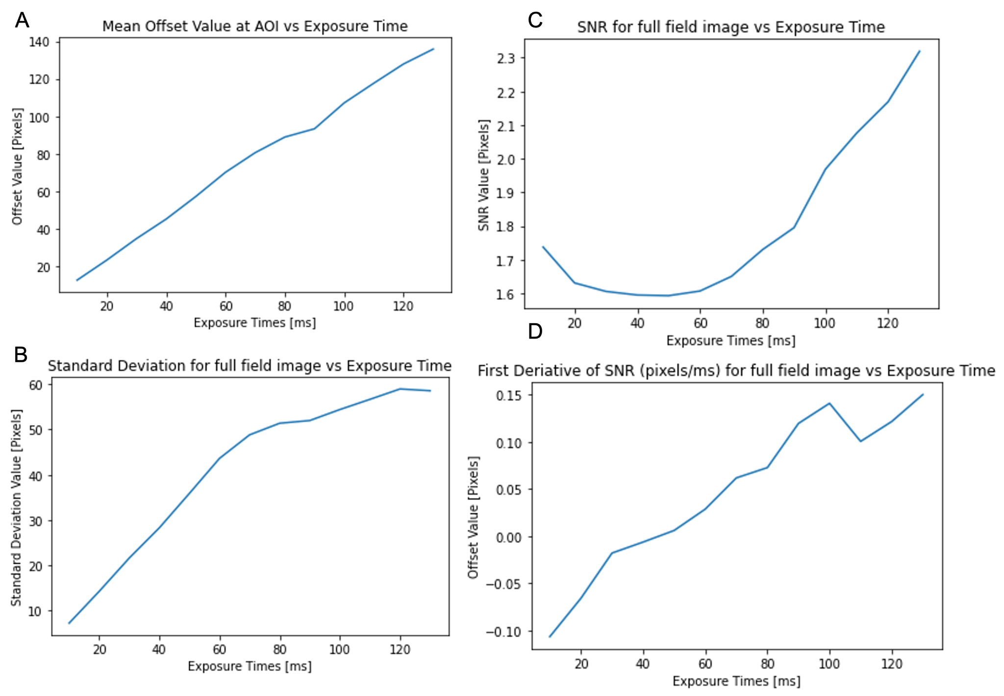

Slide 6
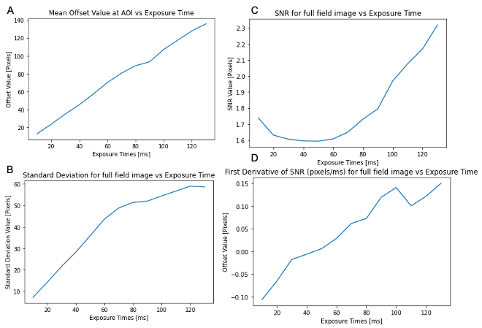

Slide 7
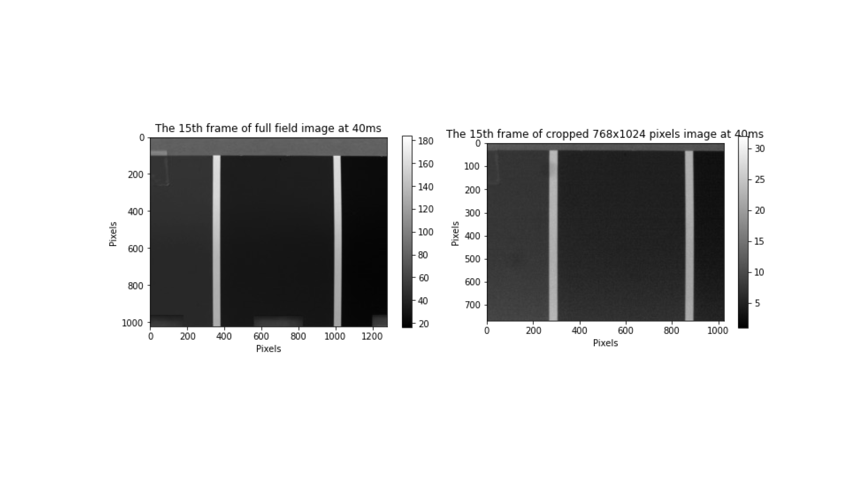

Slide 8
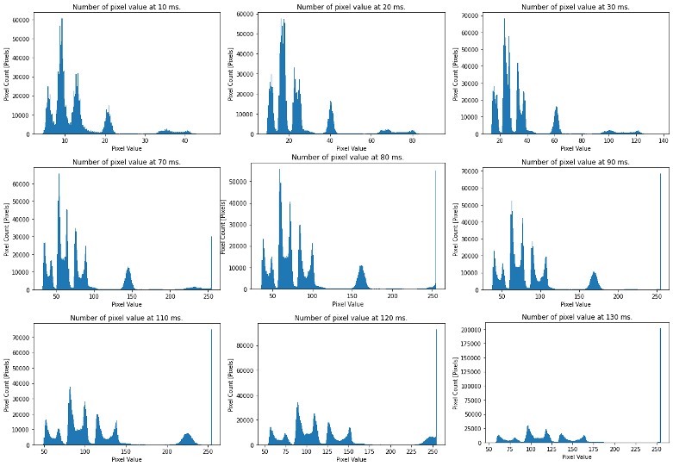

Slide 9
